Slide 1
Final Intern Review
July 2018

Slide 2
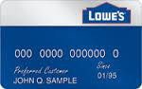
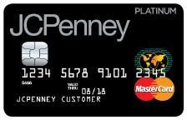
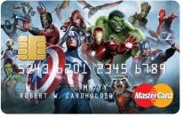
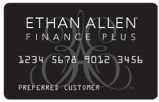
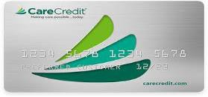
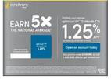
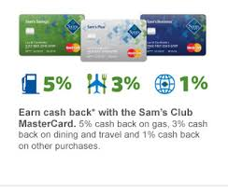


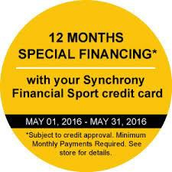


Synchrony Financial Products
Credit and Financing Consumer Banking
Retail Cards Payment Solutions CareCredit Bank
Private Label
Dual Card
Co-brand
Private Label
Private Label
Deposit Products
Retailer Only Acceptance
Accepted at Network Locations
Retailer Only Acceptance
~200K Provider Network Locations
Fast Growing Online Bank
Benefits to customers
Types
FDIC - Insured
Cash Back, Rewards, Discounts
Credit Events & Promotions
Best Customer Programs
Home
Furniture
Electronics
Luxury
Power sports
Dental
Vision
Cosmetic
Veterinary
Certificates of Deposit
Money Market Accounts
Savings Accounts
IRA Money Market Accounts
IRA Certificates of Deposit
6

Slide 3
Credit Card Life Cycle
Payment Gateway
Card Network
Customer
f
Merchant
Processor
The card holder initiates a purchase
Processes credit card information and requests authorization
It routes information to the processor
Processor submits authorization request to card network
It submits authorization request to the issuer
Card Network
Customer
Merchant
Acquirer
Issuer
The customer receives the purchased item or services.
The merchant accepts the transaction
Acquiring bank forwards authorization to merchant
It forwards the authorization response to acquiring bank
The issuer approves transaction.

Slide 4

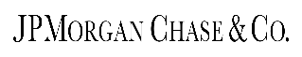



Facial Recognition Importance
Major Use - Cases
Security
HealthCare
Marketing
Fraud Detection
Reduce password
Distinguish human face and photograph
More accurately track patient medication consumption
Pain Management
Targeting more customers using social media
FinTech Uses
Face ID for Iphone X
Face ID for Iphone X
Face ID Login
IRA Robot for customer Identification and Balance Enquiry
Facial Recognition in ATMS

Slide 5
Existing Process
Built Process
Image/Test Image
Image/Test Image
Library Face_recognition
Face Encoding
Face detection
Face Align
Library Face_recognition
Deep Learning Model
Regression Tree Model
Database
Facial Encoding
Face Encoding
Database
Deep Learning Model
Compare
Compare
Match
Not Match
Match
Not Match

Slide 6
CHAT BOT
A chatbot (also known as a talkbots, chatterbot, Bot, IM bot, interactive agent, or Artificial Conversational Entity) is a computer program or an artificial intelligence which conducts a conversation via auditory or textual methods.
CHAT BOT
Algorithms
Natural Language Processing
Scan for keywords within the input, then pull a reply with the most matching keywords
FinTech Use Cases
PERSONAL BANKING SERVICES
UNINTERRUPTED CUSTOMER SUPPORT
CUSTOMER FEEDBACK & MEASUREMENTS
DELIVERING PERSONALIZED MARKETING
EMPLOYEE SELF-SERVICE

Slide 7
HR Bot
It is an employee self-service bot. It is used to automate answering repeated general HRM queries.
Query Type
Paycheck
Payroll
HR Policy and Procedures
Provident Fund
GPA and Medical Insurance
GTL Insurance
Gym/Fitness
Gratuity
Workday Leaves
Job Posting
Referral Incentive
Salary Advance
EAP
Zeta/ Meal Card
Day Care
Long Service Award
Fin Tech Use Case
Wells Fargo
Discover
Bank of America
JP Morgan Chase
Capital one
Banking Assistant Facebook chatbot
Replaced live cha t with messaging mobile app.
Erica, voice and text powered client assistant chatbot
Erica, voice and text powered client assistant chatbot
Banking Assistant Facebook chatbot

Slide 8
Retrieval based FAQ Bot - Architecture
Text
Driver Program
(Java Script)
Text
User Interface for Chat
Machine Learning Service
(Custom/uses RASA-NLU framework)
Intent
Response
Prepare data for Model learning
Intent
FAQ Database
Response

Slide 9
Various Model Approach
First
Question
Data Stemming
Bayesian Classifier for Intent Classification
Second
Data Stemming
Data Stemming
SVC intent classification
Question
Word to vector
Most Accurate
Question
Spell Check
Data Cleaning
Data Stemming
NN sub-intent classification
NN intent classification
Word to vector

Slide 10
Validation/Test Accuracy – Model Comparison
Model | Basic Data | Basic Data + Text Cleaned | Basic Data + Text Cleaned + Pre - processing | Basic Data + Text Cleaned + Pre - processing + Less Intents
SVM | 61.3% | 68.9% | 75.4% | 83.5%
MLP | 71.2% | 78.7% | 80.1% | 92.5%

